Slide 1


Data Analysis Platform

Slide 2

Par mums
Viena no pirmajām programmēšanas skolām Lietuvā un Latvijā;
Skolas filiāles Viļņā, Klaipēdā, Kauņā un Rīgā;
Vairāk nekā 1500 absolventi;
80% absolventu, kas vēlas strādāt IT jomā;
Vairāk nekā 50 sadarbības uzņēmumu Rīgā;
Skolas lektori – ar pieredzi IT sfērā.

Slide 3
VALDIS
Izglītība: Maģistra grāds datorzinātnēs
Pieredze programmēšanā: 20+ gadi
Specialitāte: grafu teorija sociālo tīklu analizēšanā
Hobiji: prāta spēles, riteņbraukšana, šahs
RCS Pasniedzu: Python iesācējiem, Datu Analīzes kursus

Slide 4

Data Lake

Slide 5
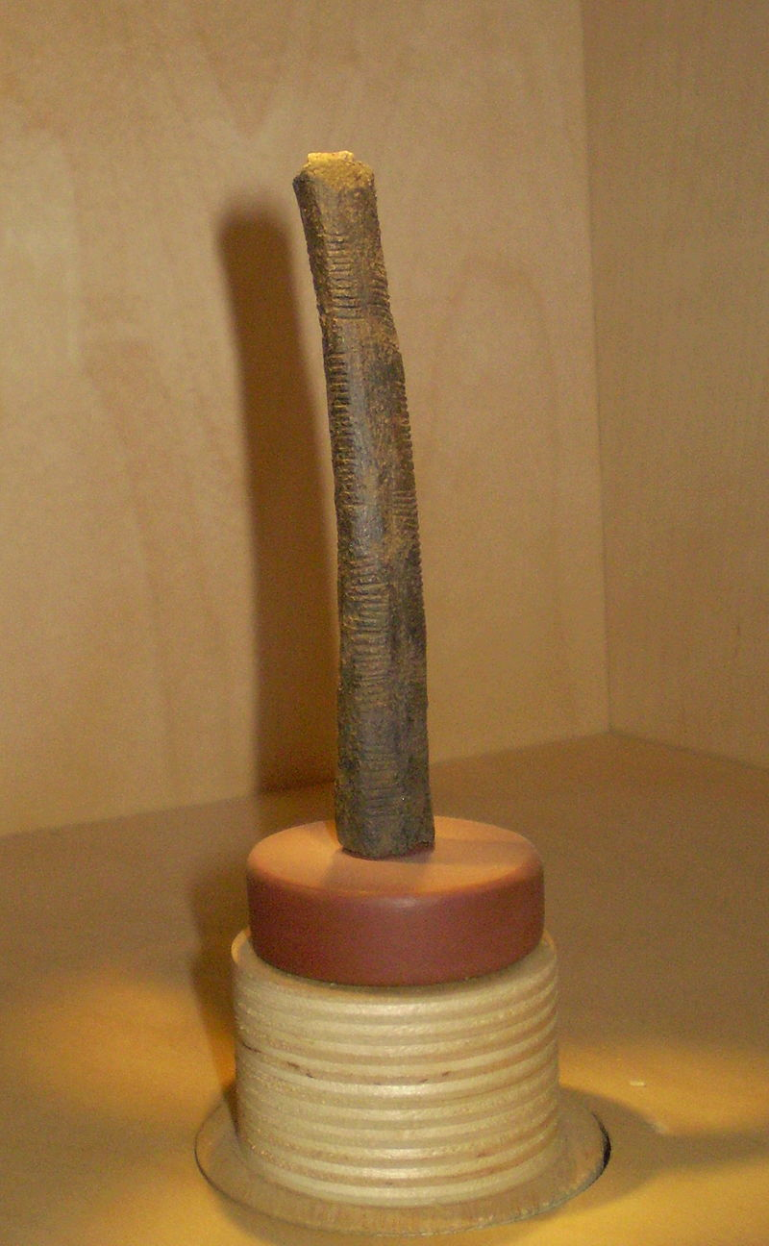
Brief History of Data Analysis
~ 18,000BC – Uganda, Ishango Bone
~ 2400BC – Babylon abacus, libraries
300BC – 48AD – Library of Alexandria
~ 100-200AD Antikythera Mechanism

Slide 6
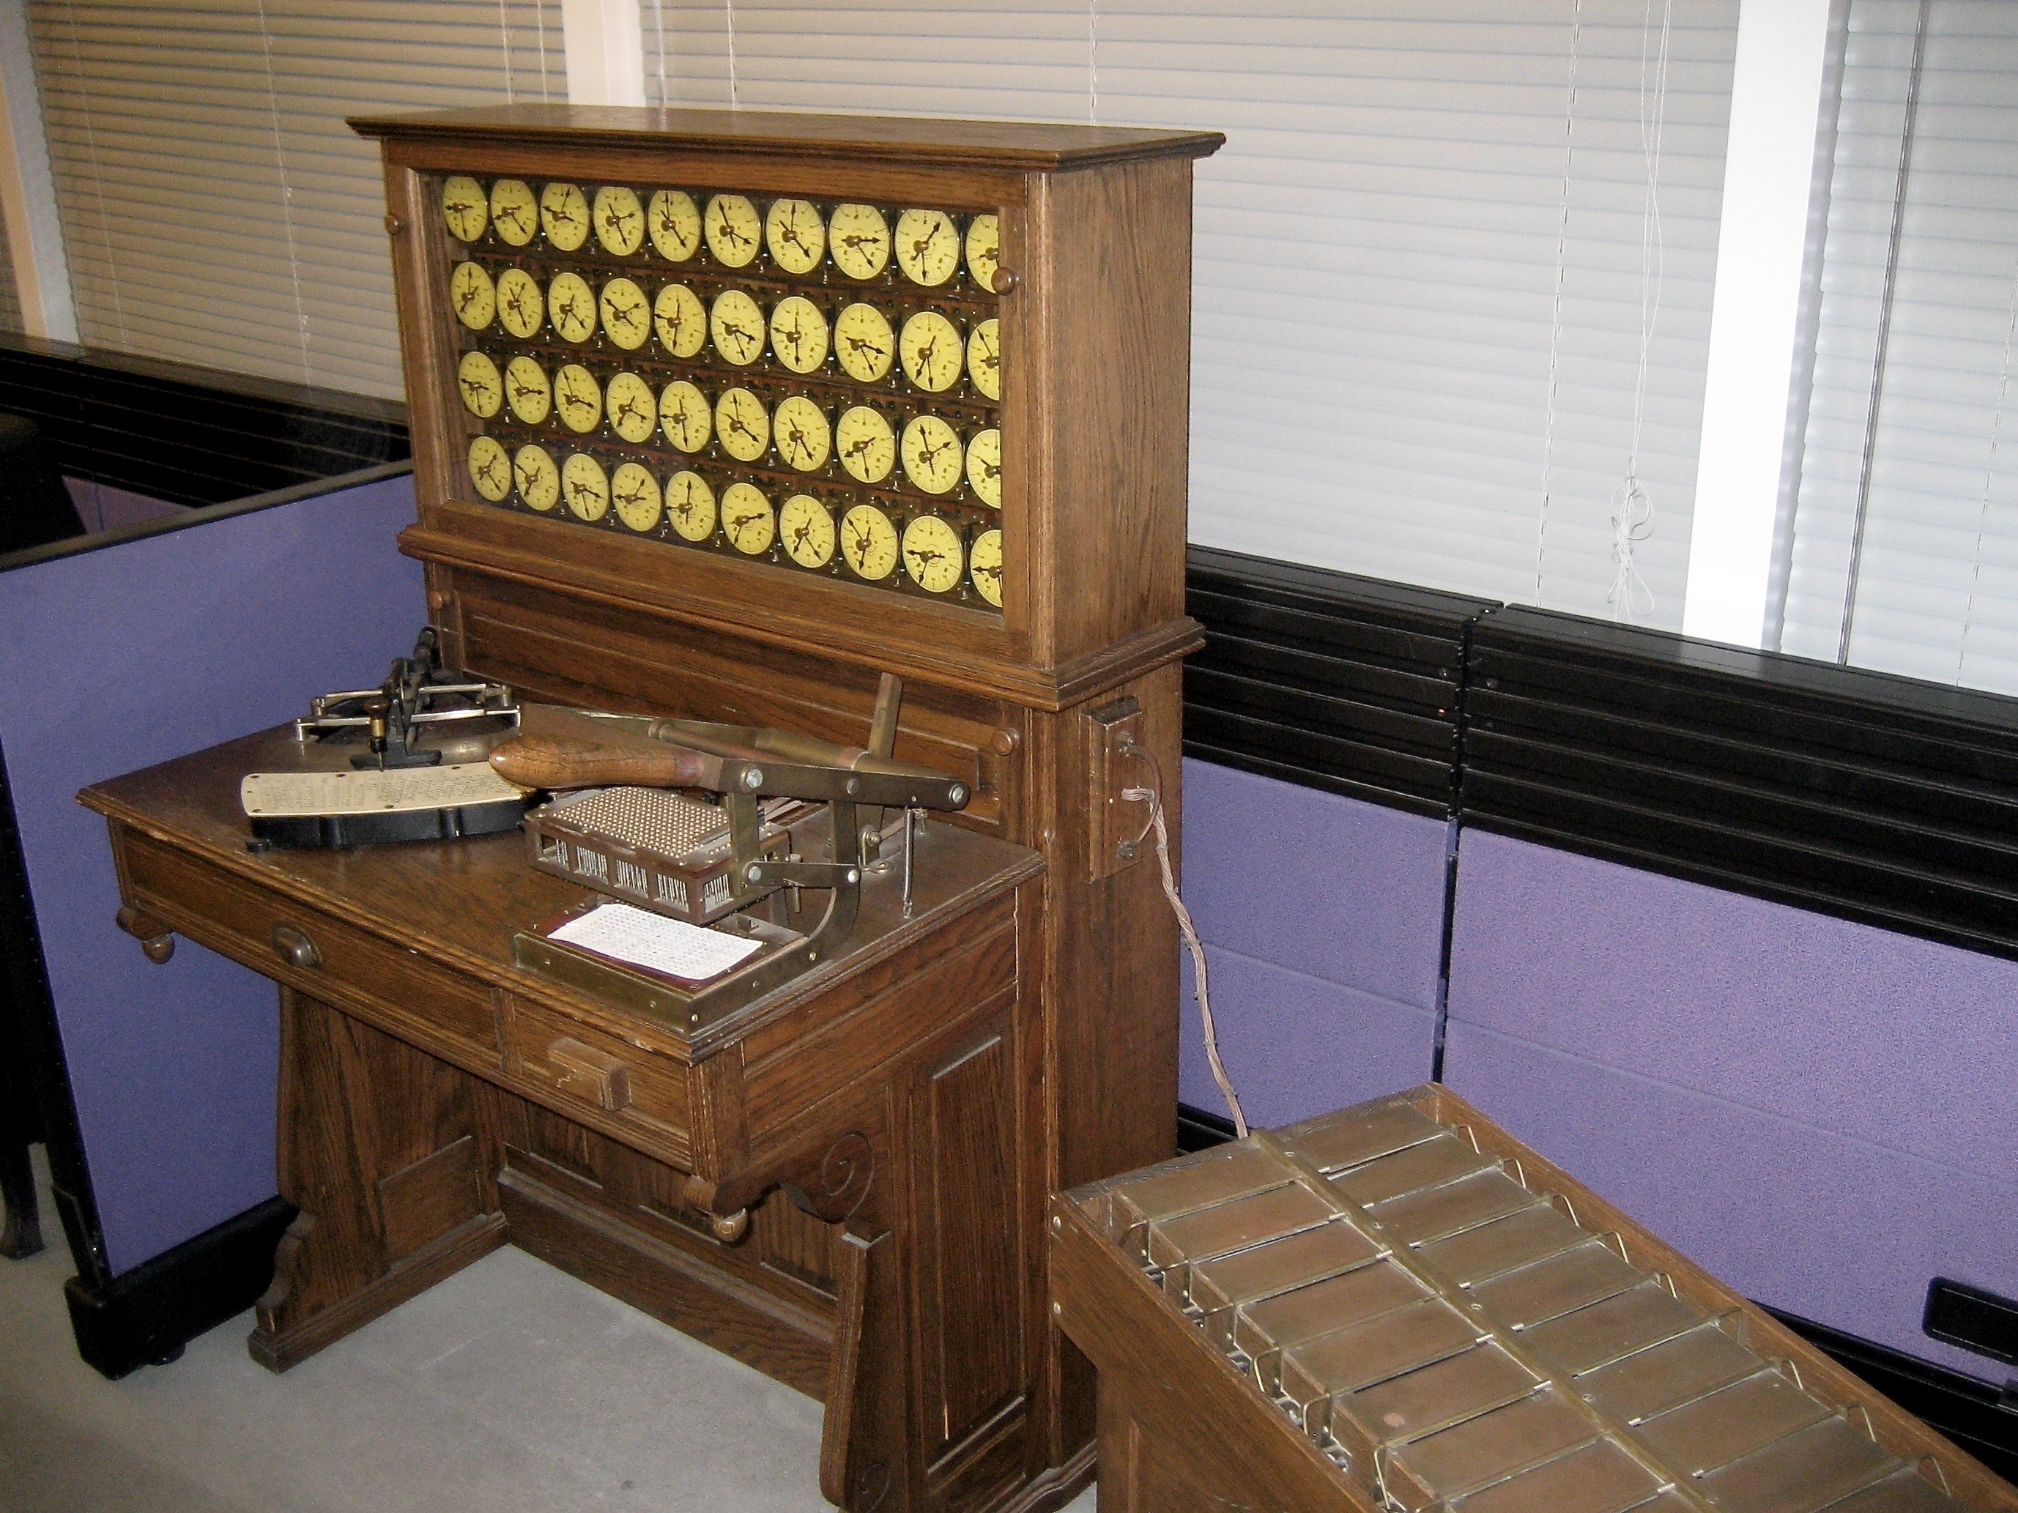
Brief History of Data Analysis II
1663 – London, J.Graunt mortality analysis
1865 – banker H. Furnese business intelligence
1880-90 US Census Hollerith Machine -> IBM
1928 – F. Pfleumer magnetic tape invention

Slide 7

Brief History of Data Analysis III
1950s - Flat Files
1958 – IBM’s Luhn defines Business Intelligence
1960s - CODASYL
1970s – Codd’s relational DBs -> SQL
1980s – Data Werehouses / Marts
2000s – Big Data / noSQL DBs
2010s – Rise of accessible ML/DL libraries

Slide 8
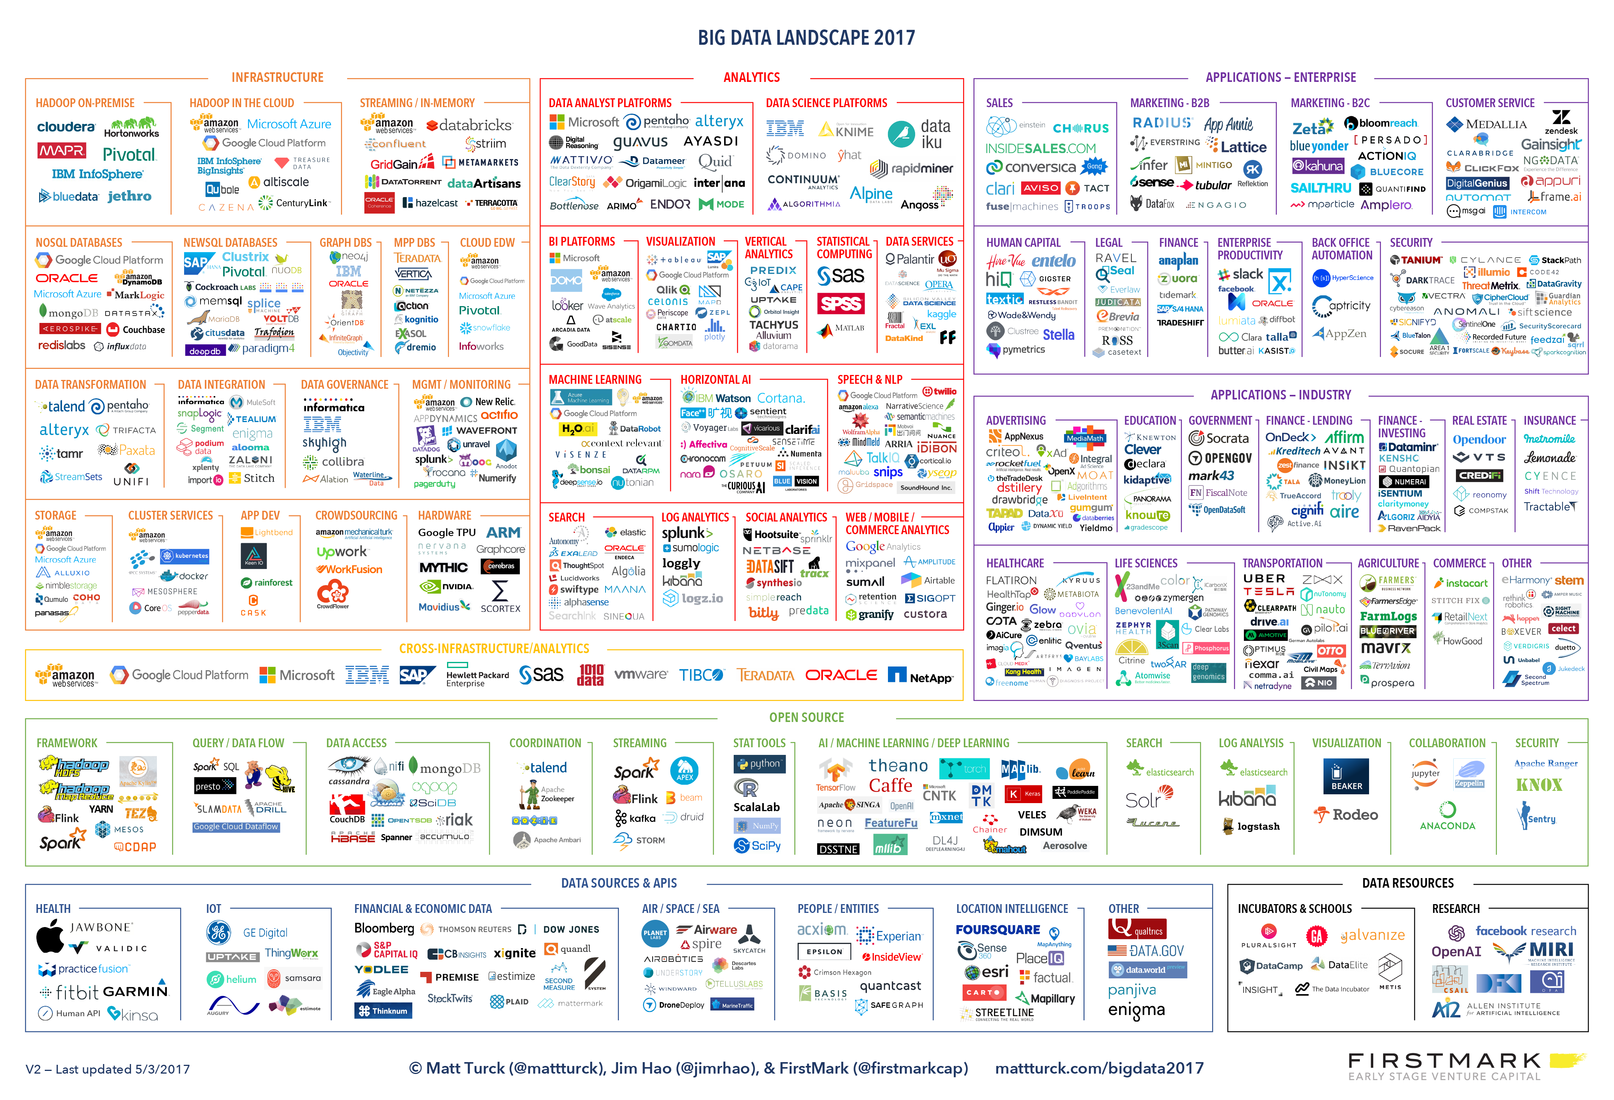

Slide 9
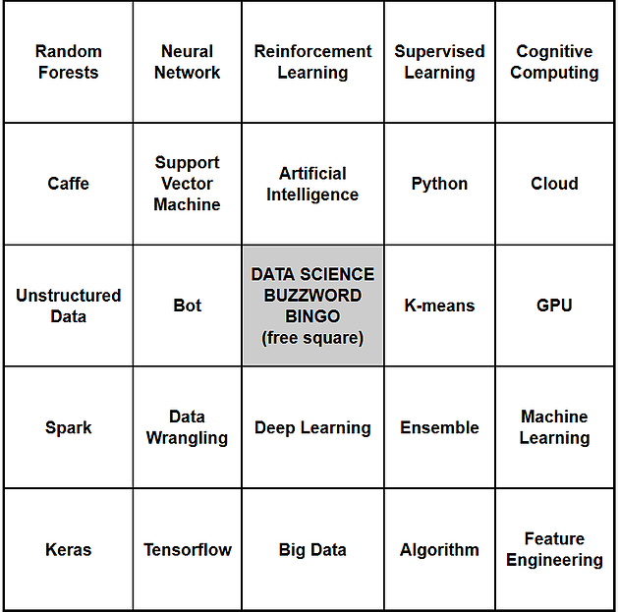
Buzzword bingo
Big Data
Data Mining (datizrace)
Machine Learning – subset of AI
Data Science – statistics
Big Data or Pokemon
https://pixelastic.github.io/pokemonorbigdata/

Slide 10

Data Mining
Anomalies
Classification
Clusters
Dimension Reduction
Regression
Relationship finding
Summarization / Visualization

Slide 11
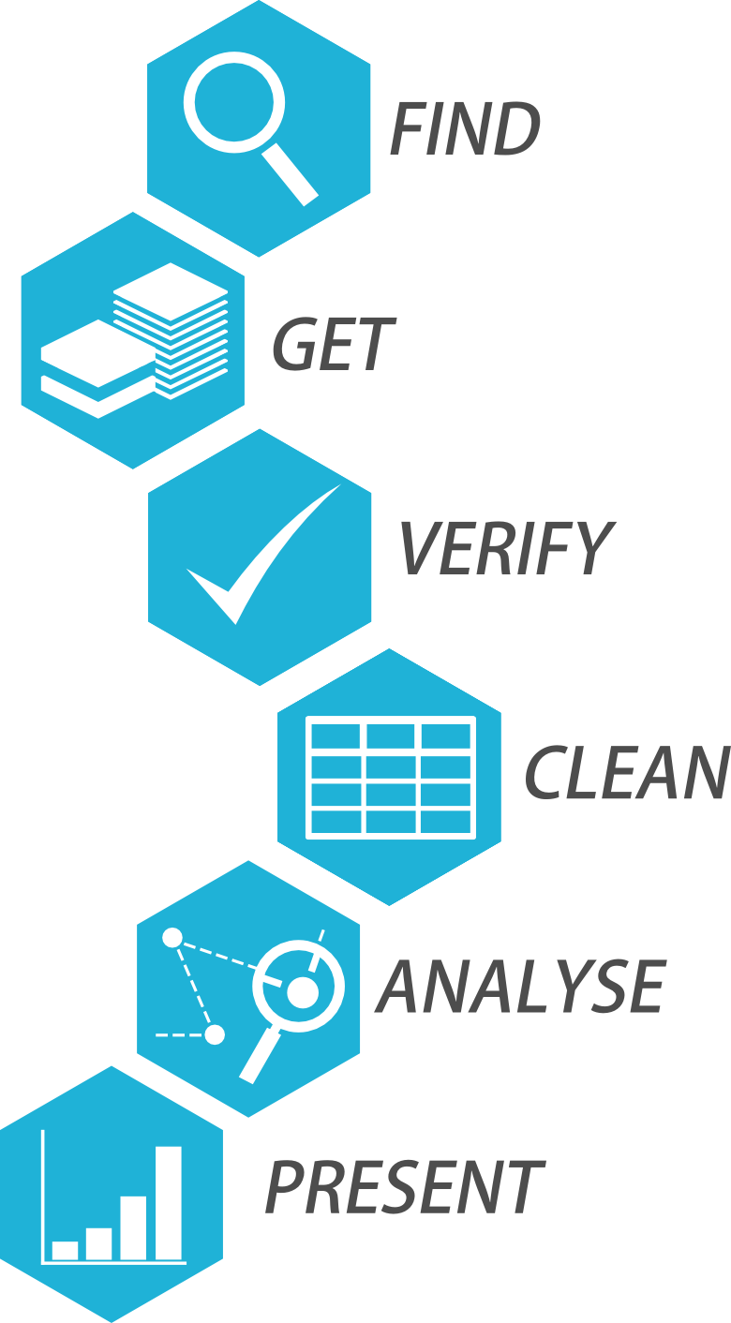
Building a Pipeline
Data Security
Cleanup
Organising Database
Analysis
Visualization – Dashboard
Emphasis on Analysis less on Infrastructure

Slide 12
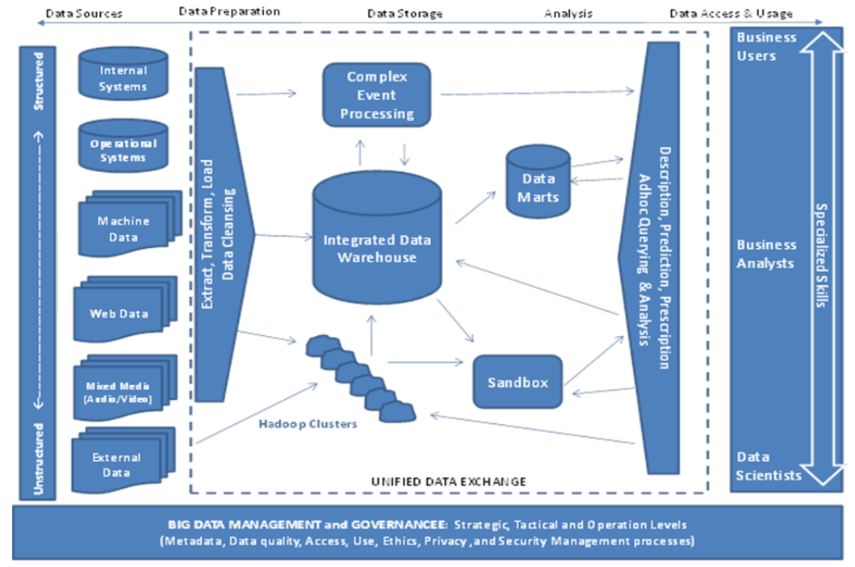
Full Analysis Framework

Slide 13

Sandbox for solutions

Slide 14
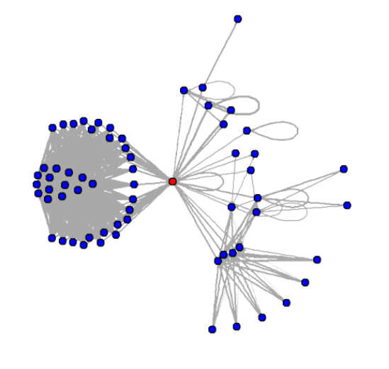
Common Projects
Recommendation System / Churn Prediction
Web Comments Sentiment Analysis
Network Analysis (such as transactions on blockchain)

Slide 15

Avoiding Pitfalls
Overfitting
Data Dredging / p-hacking
https://xkcd.com/882/

Slide 16

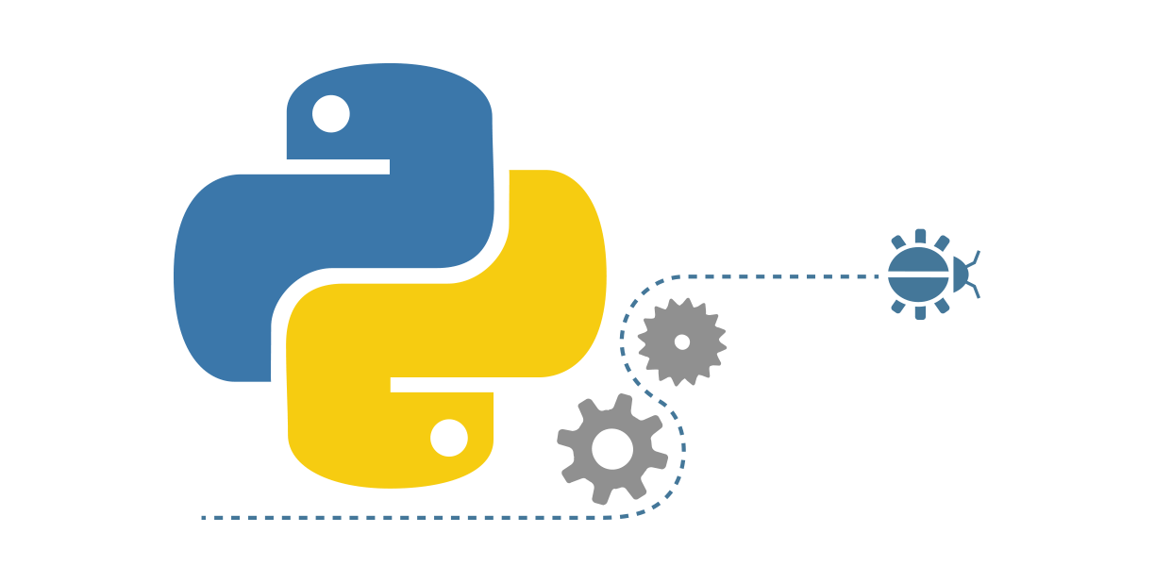
Python Programming Language
#3 in TIOBE language index
#1 in Popularity of Programming Languages index
General purpose / readable
2018 Nobel Economist Paul Romer recommended!

Slide 17


Resources
Anaconda - The Most Popular Python Data Science Platform
(includes Jupyter) : https://www.anaconda.com/download/
Github: https://github.com/ValRCS/RigaComm_DataAnalysis

Slide 18
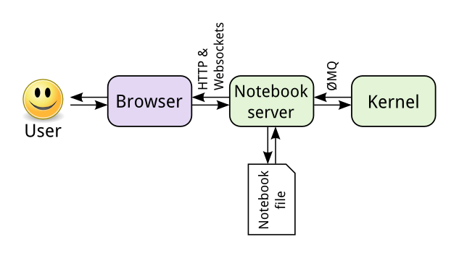
How Jupyter Works

Slide 19
Jupyter Hosted in the Cloud
Microsoft - https://notebooks.azure.com/
Google - https://colab.research.google.com/notebooks/welcome.ipynb
IBM - https://dataplatform.cloud.ibm.com/
Anaconda Cloud : https://anaconda.org/
MyBinder – https://mybinder.org/
Self Hosted or just run locally by installing Anaconda

